Slide 1

Introduction to Software Testing By Dr. Praveen Kantha

Slide 2
Software Testing

Slide 3
White Box Testing
White box testing is an approach that allows testers to inspect and verify the inner workings of a software system—its code, infrastructure, and integrations with external systems.
White Box Testing is also known as transparent testing, open box testing.
It is used to test the software’s internal logic, flow, and structure.
The tester creates test cases to examine the code paths and logic flows to ensure that they meet the specified requirements.

Slide 4
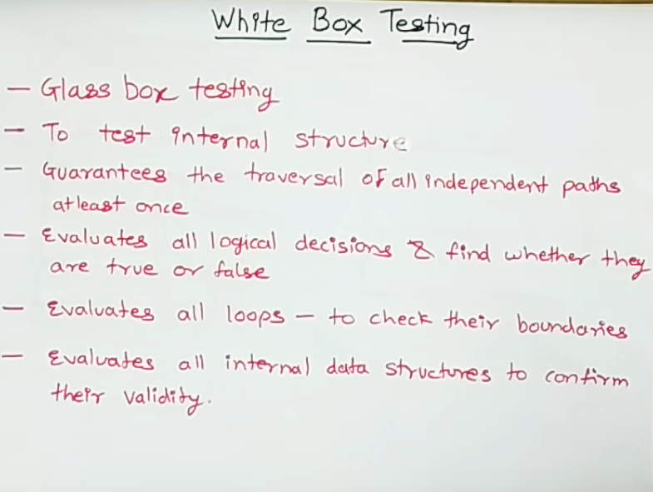

Slide 5
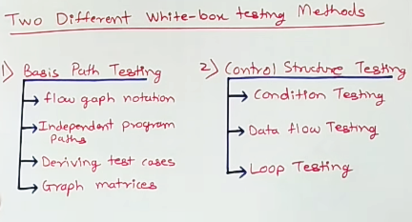

Slide 6
White box Testing techniques:
Basis Path Testing : Basis Path Testing is a white-box testing technique based on the control structure of a program or a module.
Basis path testing is a technique of selecting the paths in the control flow graph, that provide a basis set of execution paths through the program or module.
The objective of basis path testing is to define the number of independent paths, so the number of test cases needed can be defined explicitly to maximize test coverage.

Slide 7
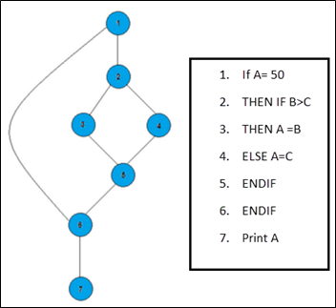
White box Testing techniques:
In the above example, we can see there are few conditional statements that is executed depending on what condition it suffice. Here there are 3 paths or condition that need to be tested to get the output,
Path 1: 1,2,3,5,6, 7
Path 2: 1,2,4,5,6, 7
Path 3: 1, 6, 7

Slide 9
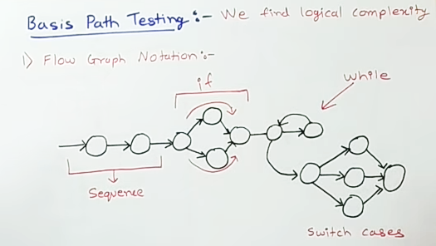

Slide 10
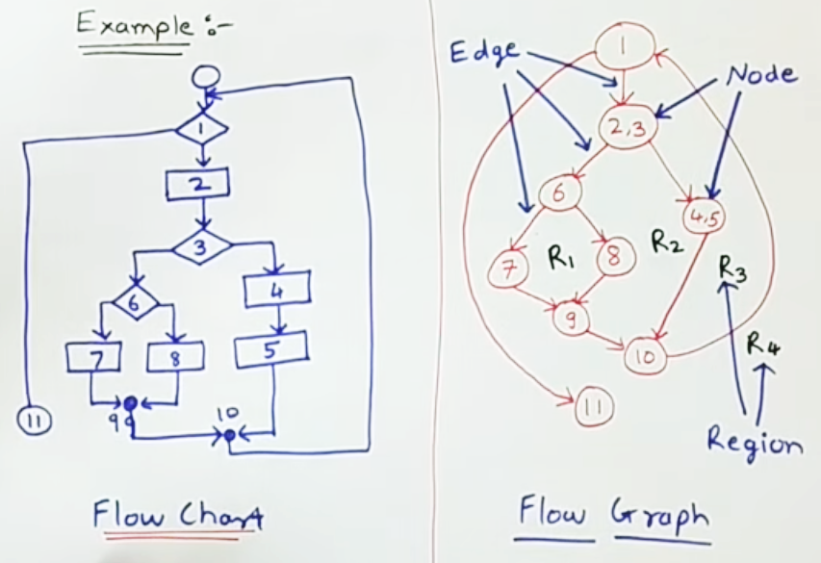

Slide 11
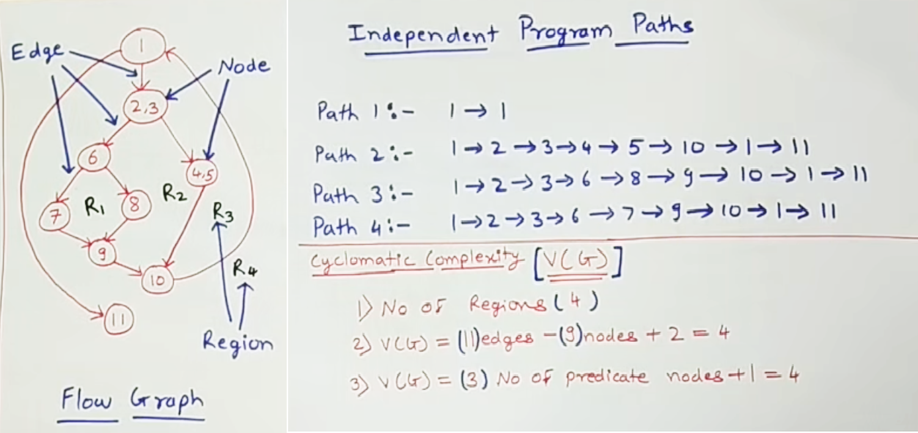

Slide 12
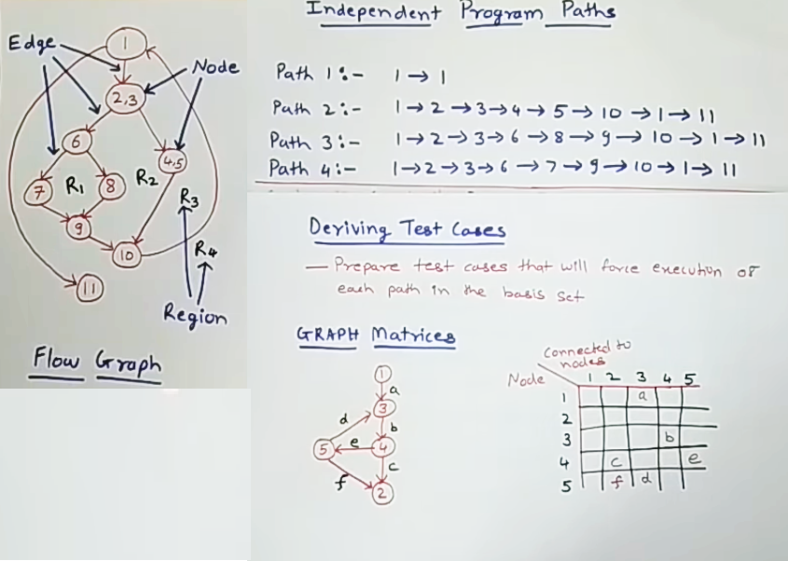

Slide 13
Control Structure Testing
Control structure testing is a group of white-box testing methods.
• Branch Testing
• Condition Testing
• Data Flow Testing
• Loop Testing

Slide 14
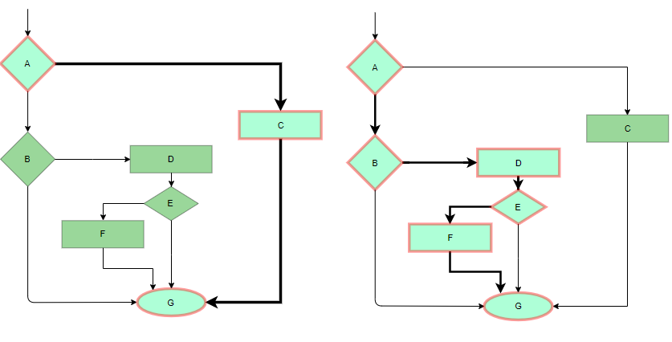
White box Testing techniques:
Statement Coverage: In this technique, the aim is to traverse all statement at least once. Hence, each line of code is tested.
In case of a flowchart, every node must be traversed at least once. Since all lines of code are covered, helps in pointing out faulty code.

Slide 15
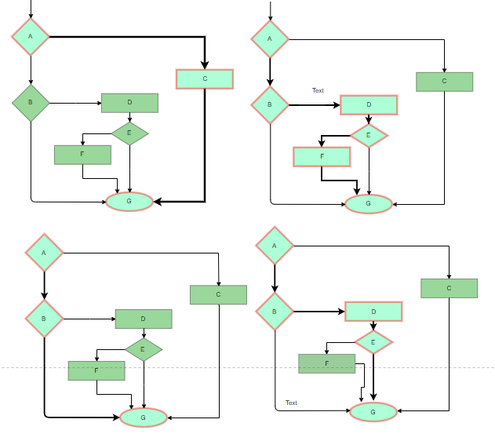
White box Testing techniques:
Branch Coverage: In this technique, test cases are designed so that each branch from all decision points are traversed at least once.
In a flowchart, all edges must be traversed at least once.

Slide 16
White box Testing techniques:
Data Flow Testing:
It is one of the white-box testing techniques.
Dataflow Testing focuses on two points:
1) In which statement the variables are defined.
2) In which statement the variables are used.
It designs the test cases that cover control flow paths around variable definitions and their uses in the modules.

Slide 17
White box Testing techniques:
 | Define | Use
a | 1 | 2,3
b | 1 | 2,5
c | 1 | NA
x | 3,5 | 4
z | NA | 6
1.read a, b, c;
2. if(a>b)
3 x=a+1
4. Print x;
else
5. x = b-1
6. print z;

Slide 18
Advantages of Data Flow Testing:
A variable that is declared but never used within the program.
A variable that is used but never declared.
A variable that is defined multiple times before it is used.
Deallocating a variable before it is used.

